Slide 1
PPG Force Sensor
7/6/2021

Slide 2
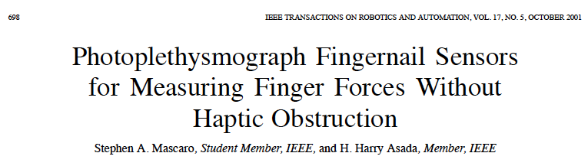
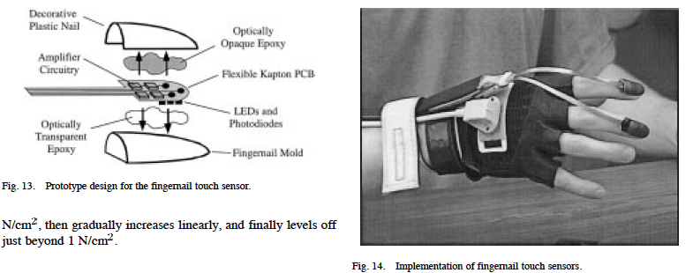
Hypodermal photoplethysmography sensor
Photoplethysmography (PPG) = optical sensing of blood volume changes in microvasculature.
PPG is commonly deployed on wearables: finger clips, smartwatches, etc.
Typically measures oxygen saturation, blood pressure, cardiac output
However, it has also been used to measure fingertip forces noninvasively from fingernail:

Slide 3

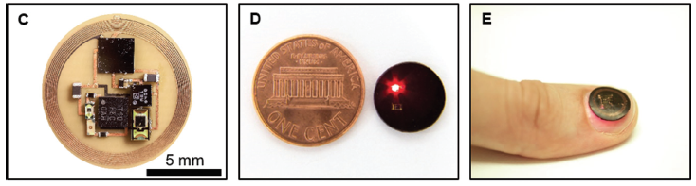
Hypodermal photoplethysmography sensor
Wearable PPG has even been implemented in a wireless, battery free device

Slide 4
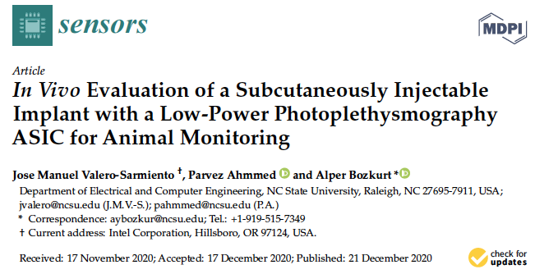
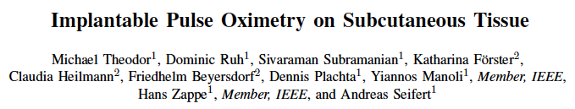
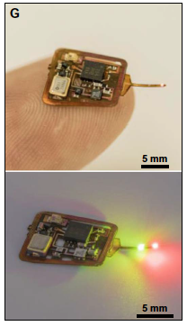
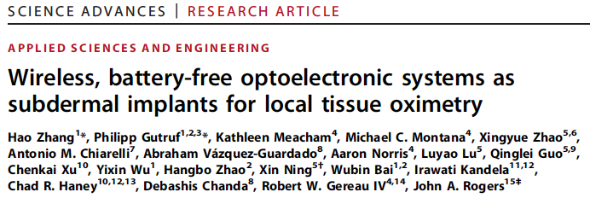
Hypodermal photoplethysmography sensor
Implantable PPG sensors for cardiovascular applications, but not for tactile sensing

Slide 5
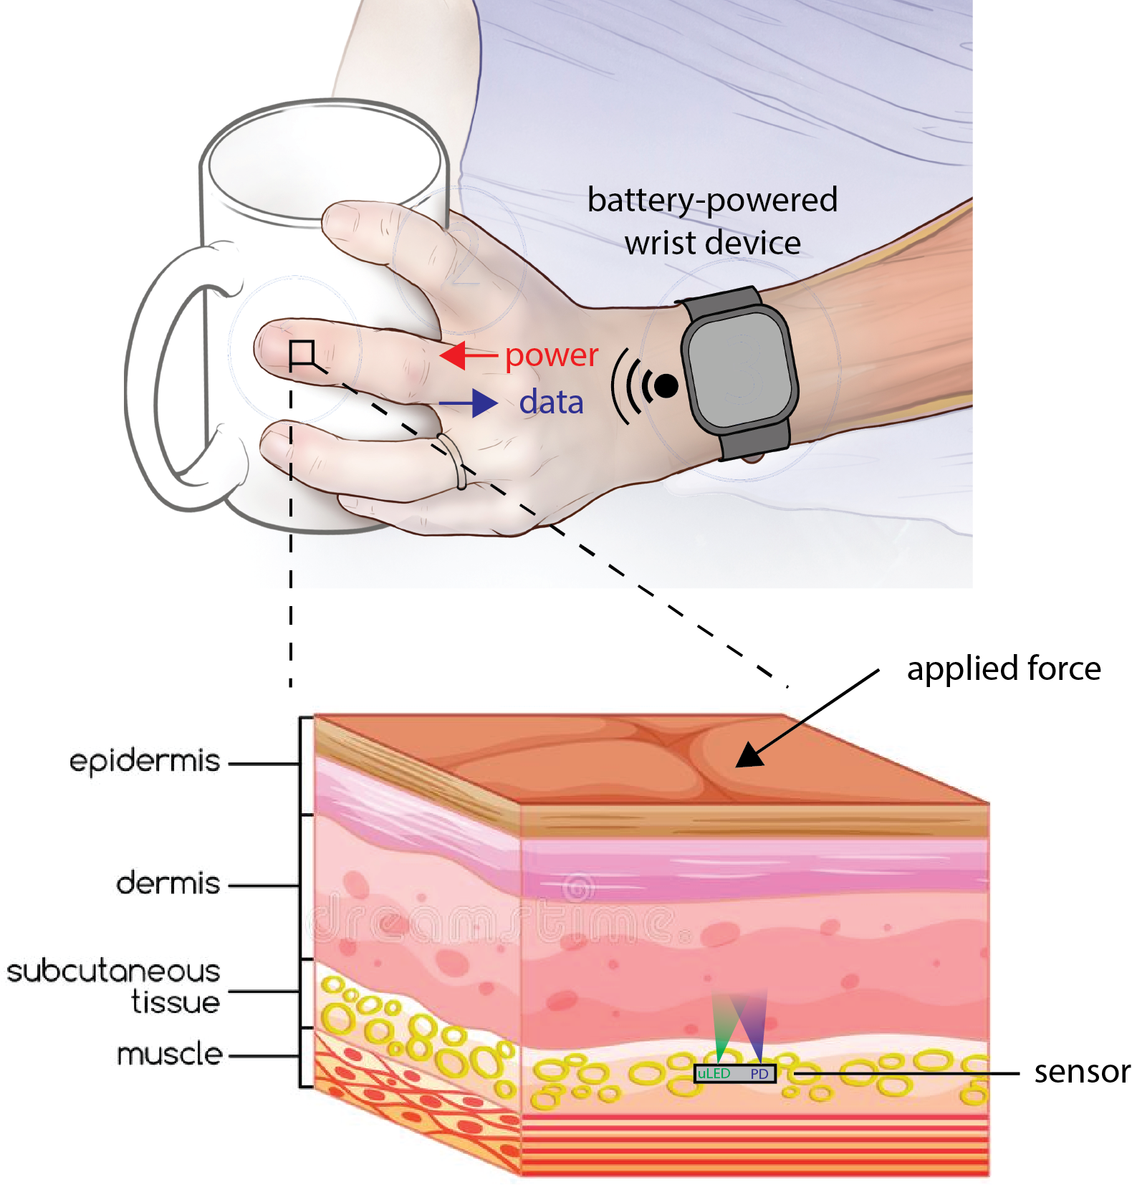
Hypodermal photoplethysmography sensor
Implantable PPG sensor for tactile sensing?
Implement off-the-shelf design of Kim et al 2017, but within fused silica package?

Slide 6
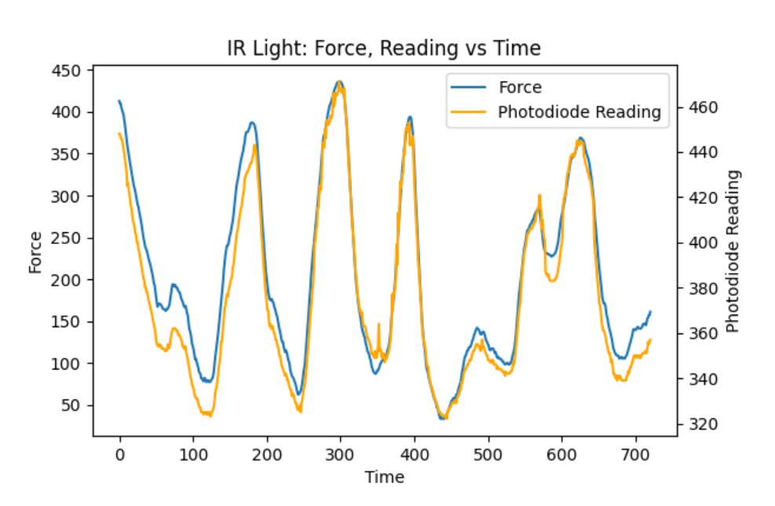
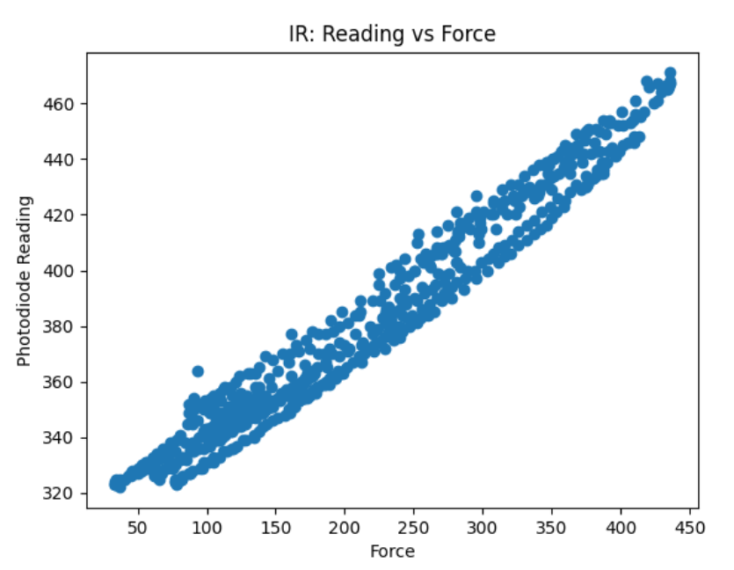
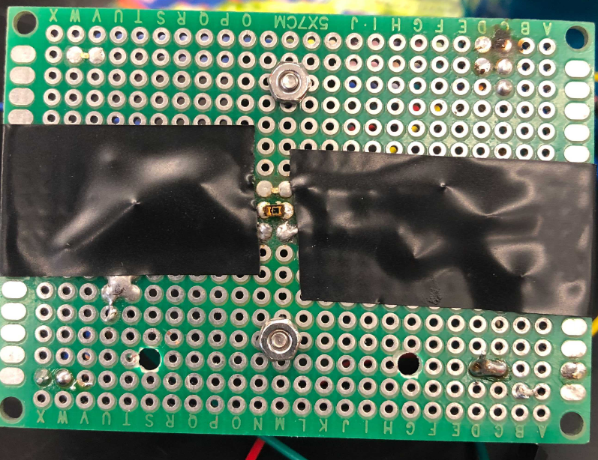
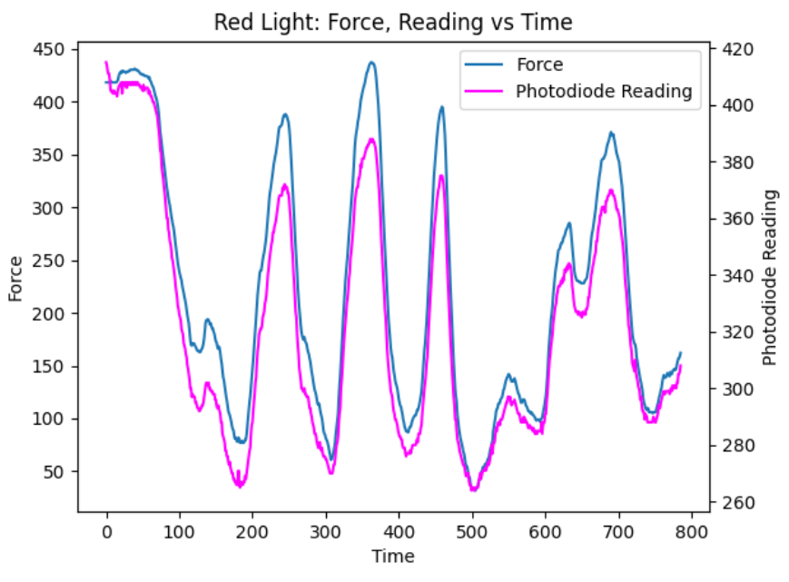
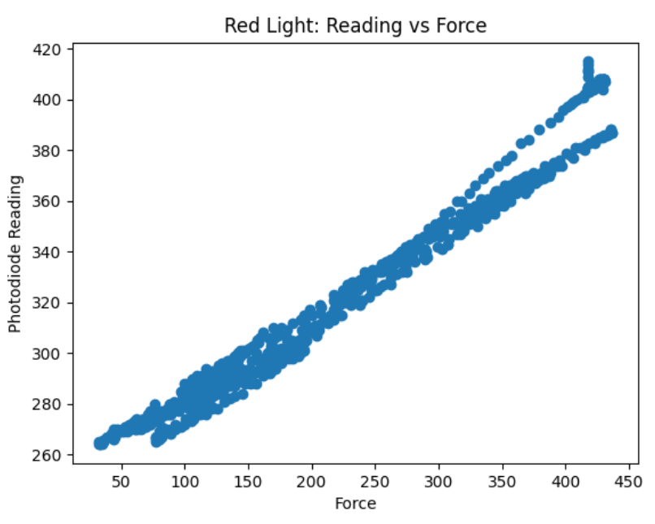
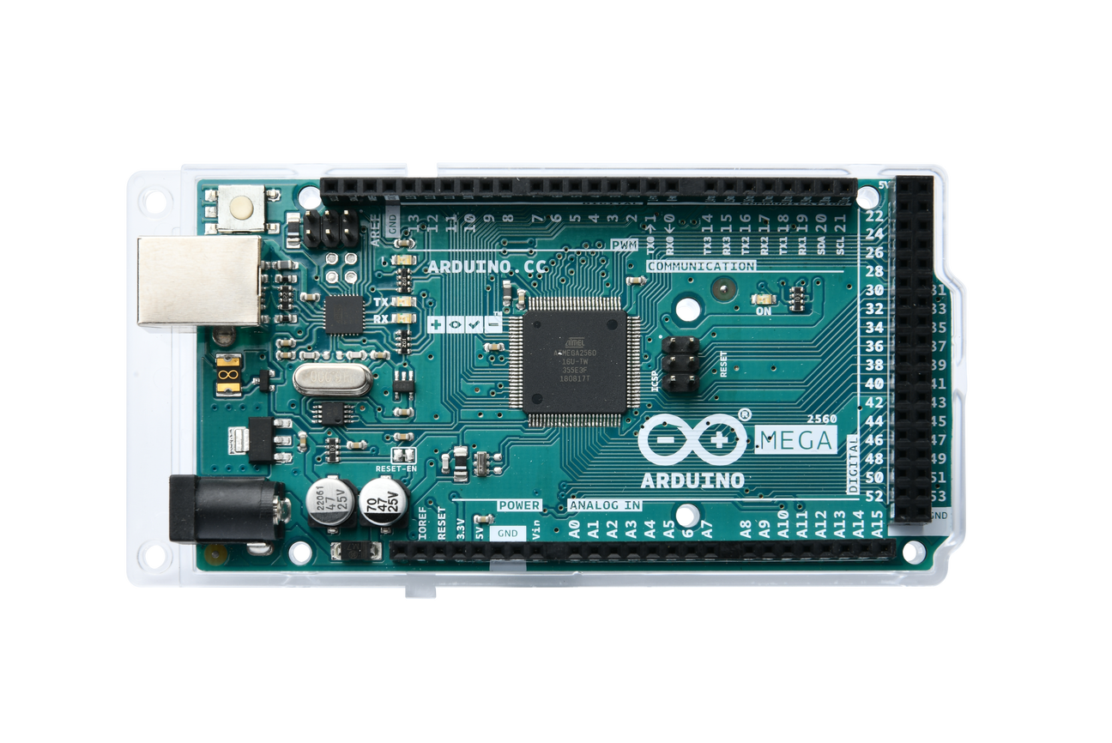
PPG Sensor: 1st Iteration
Proof-of-concept: Red + IR LED, photodiode
Red LED
Photodiode
IR LED

Slide 7
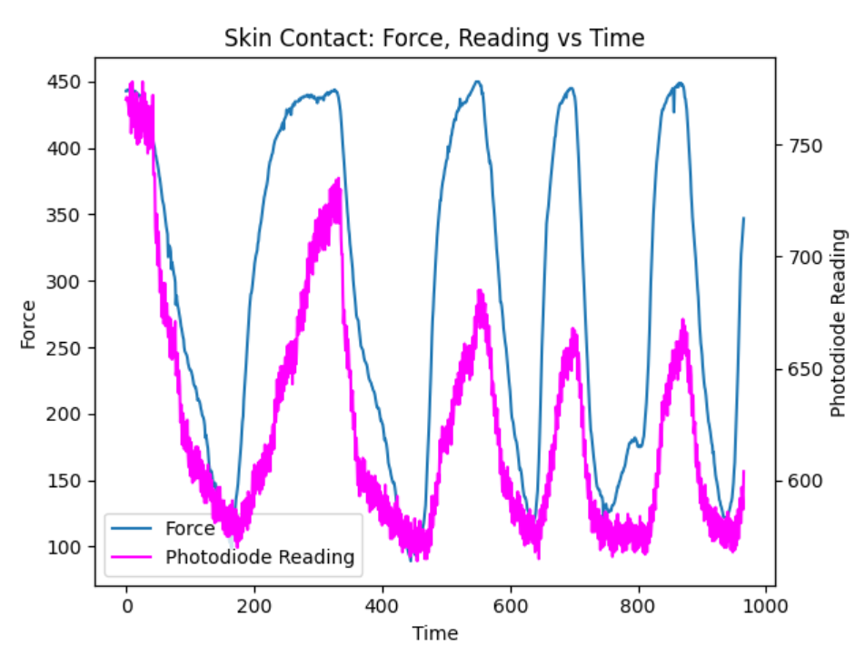
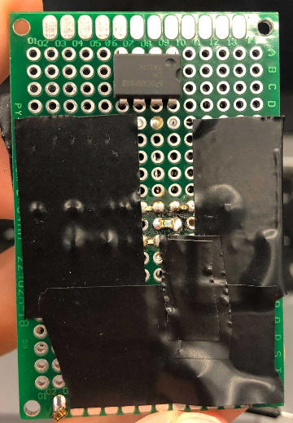
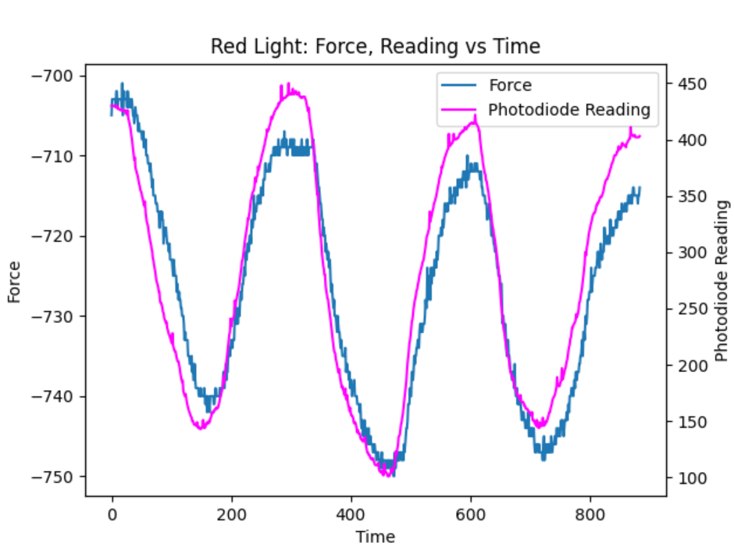
PPG Sensor: 2nd Iteration
op-amp
Red LED
IR LED
Green LED
Added green LED, op-amp to replace resistors
PD not sensitive to green LED light
Force tracked a bit too well in the last one…
Arduino ADC readings affected each other due to high output impedance of PD circuit => op-amp buffer
Skin contact with wires also led to a falsely increased response
Might be worth looking into…
Added clear plastic layer between thumb and sensor
PD

Slide 8
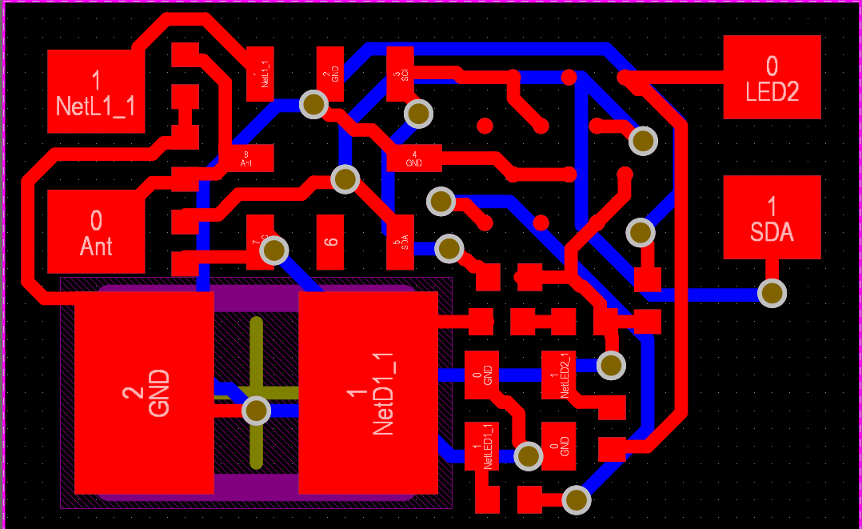
PPG Sensor – Miniaturized PCB
Programming
Headers
4.95 mm
Components:
ATtiny20 – LED switching, ADC samples photodiode output, sends data to NFC
NFC chip: receives power, transmits photodiode readings
Red, IR LED
Photodiode
Adding Revisions:
Op Amp buffer?
Can use smaller PD
Min Manufacturing size: 5x6 mm => indicators for debugging
3.75 mm

